Slide 1
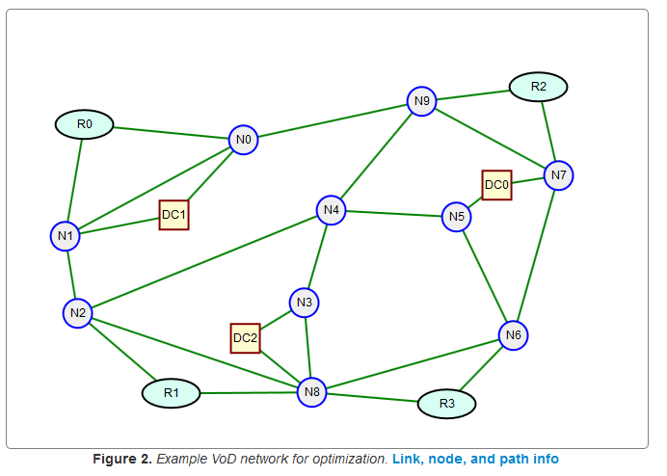
Network Design Problems: An Overview
B
Dr. Greg Bernstein
Grotto Networking
Based on Chapter 2 of Pioro and Medhi
www.grotto-networking.com

Slide 2
Outline
Graph/Network Abstraction
Nodes, Links, Paths, Demands…
Link Path Formulation Example
Linear Programming Short Overview
Node Link Formulation Example
Notational Conventions

Slide 3
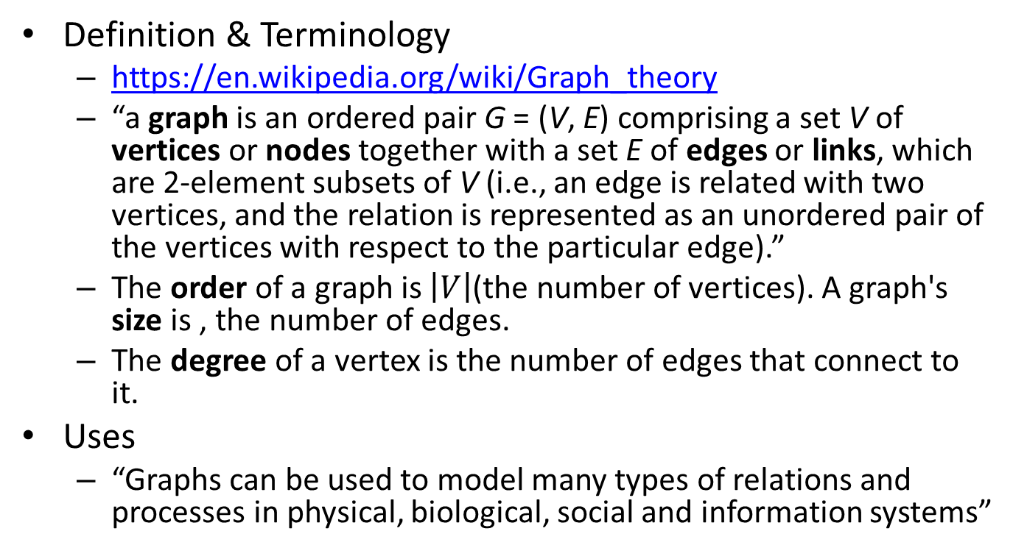
Graph Theory
Definition & Terminology
https://en.wikipedia.org/wiki/Graph_theory
“a graph is an ordered pair G = (V, E) comprising a set V of vertices or nodes together with a set E of edges or links, which are 2-element subsets of V (i.e., an edge is related with two vertices, and the relation is represented as an unordered pair of the vertices with respect to the particular edge).”
The order of a graph is $\left|V\right|$(the number of vertices). A graph's size is , the number of edges.
The degree of a vertex is the number of edges that connect to it.
Uses
“Graphs can be used to model many types of relations and processes in physical, biological, social and information systems”

Slide 4
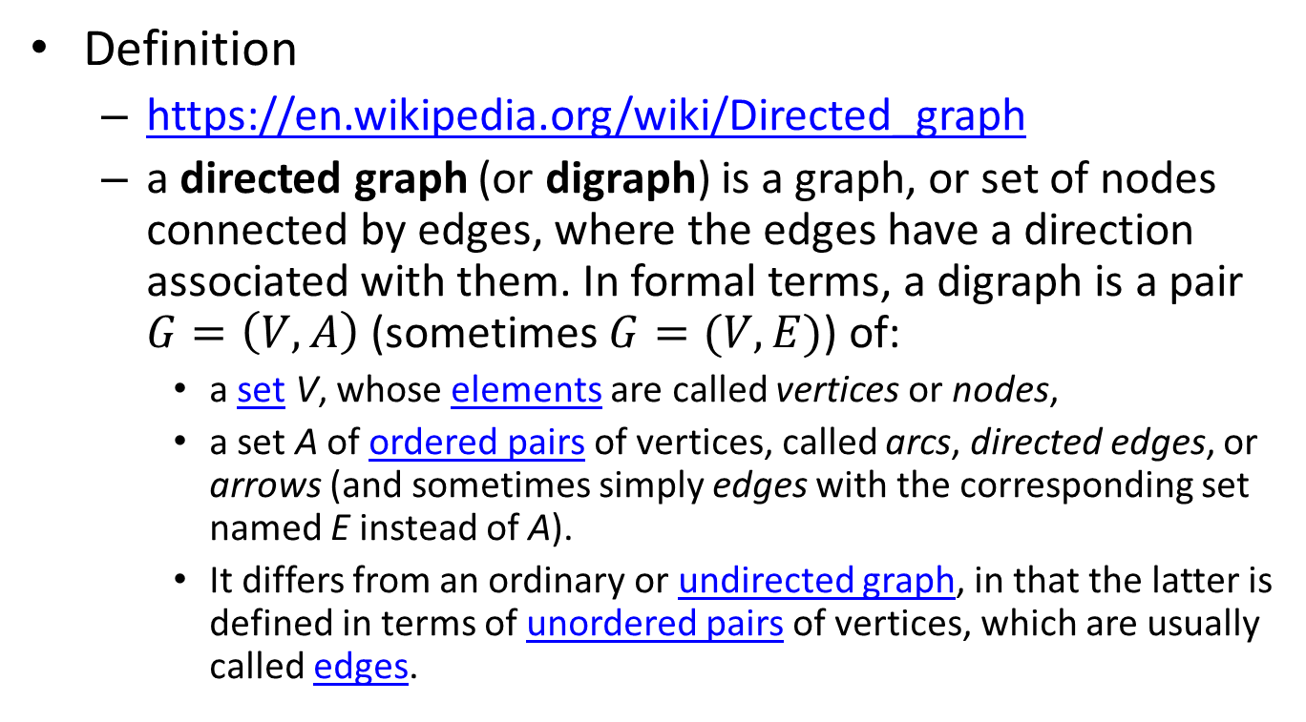
Directed Graphs
Definition
https://en.wikipedia.org/wiki/Directed_graph
a directed graph (or digraph) is a graph, or set of nodes connected by edges, where the edges have a direction associated with them. In formal terms, a digraph is a pair $G=\left(V,A\right)$ (sometimes $G=(V,E)$) of:
a set V, whose elements are called vertices or nodes,
a set A of ordered pairs of vertices, called arcs, directed edges, or arrows (and sometimes simply edges with the corresponding set named E instead of A).
It differs from an ordinary or undirected graph, in that the latter is defined in terms of unordered pairs of vertices, which are usually called edges.

Slide 5
Paths in Graphs
In general, an n-hop path between nodes v and v′ is an interlacing sequence of nodes and links of the form
(v1 , e1 , v2 , e2 , ..., vn , en , vn+1 )
where v1 = v, vn+1 = v′ , and link ei connects nodes vi and vi+1 for i = 1, 2, ..., n. If the links are directed then the path is directed, and if the links are undirected, so is the path. A path can be represented either by its nodes or links.
Page 49: Michal, Pioro,, Medhi, Deepankar. Routing, Flow, and Capacity Design in Communication and Computer Networks. Morgan Kaufmann Publishers, 07/2004..

Slide 6
Modeling Networks via Graphs
Nodes (vertices)
Correspond to routers, switches or multiplexers.
IP, Ethernet, MPLS, WDM, SONET, etc…
May have additional attributes or properties that are technology specific
Links (edges, arcs)
Correspond to physical or logical communication channels
Generally have a multiple additional attributes such as: capacity, weight, cost, reliability, current utilization, etc… Can be very technology specific.

Slide 7
Graph Theory and Networks
Graph Theory is a very broad discipline
Many results are directly applicable to networking problems
When they are that’s great since they can be much more efficient that some of our “brute force” approaches. (We’ll see this with one form of the “dimensioning problem”).
Many results are not applicable to networking problems
We will only skim the surface:
Shortest path algorithms
Spanning tree algorithms
Disjoint path algorithms
Much of what we will study is outside “graph theory”
But there is always a connection due to the ability to represent networks via graphs.

Slide 8
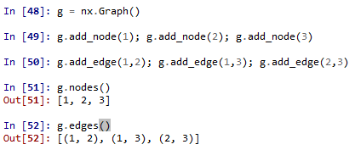
Network/Graph Example
Creates a new undirected graph
Python NetworkX representation
import networkx as nx
3
1
2
Returns a list of graph nodes
Nodes: 1, 2, 3
Links: 1-2, 1-3, 2-3
Returns a list of links as tuples
Links (edges) implemented as Python tuples

Slide 9
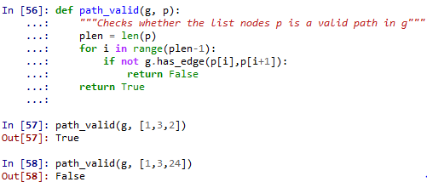
Paths Example
Paths as an ordered list of nodes
Between nodes 1 and 2: 1-2, 1-3-2
Between nodes 1 and 3: 1-3, 1-2-3
Between nodes 2 and 3: 2-3, 2-1-3
3
1
2

Slide 10
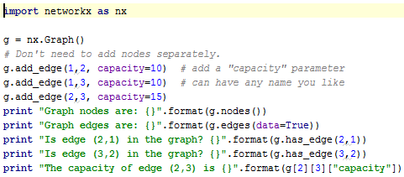




Link Capacity Attribute
Link Capacity
Either a constraint or an unknown depending on the problem
Here we will consider it as a constraint
Units are technology specific (MPLS Mbps, IP packets per second, etc…)
3
${\hat{c}}_{13}=10$
$${\hat{c}}_{23}=15$$
1
2
$${\hat{c}}_{12}=10$$
Output:
Python dictionary

Slide 11
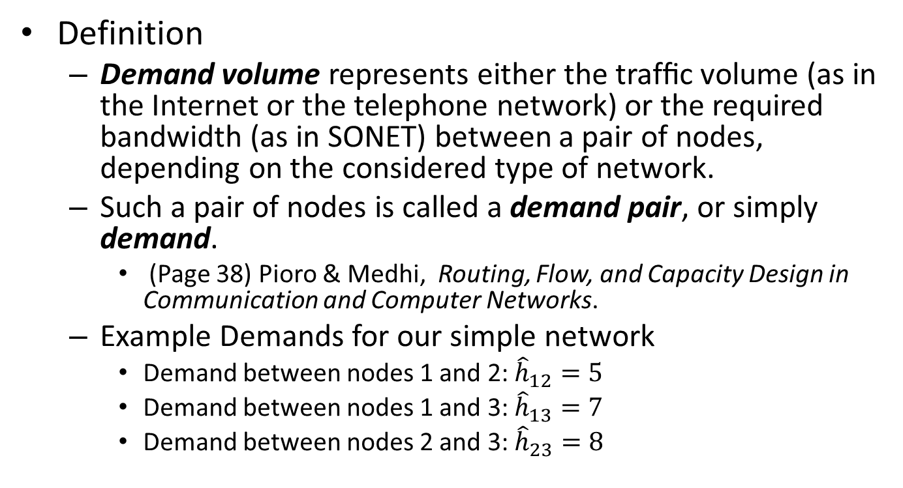
Network Demands
Definition
Demand volume represents either the trafﬁc volume (as in the Internet or the telephone network) or the required bandwidth (as in SONET) between a pair of nodes, depending on the considered type of network.
Such a pair of nodes is called a demand pair, or simply demand.
(Page 38) Pioro & Medhi, Routing, Flow, and Capacity Design in Communication and Computer Networks.
Example Demands for our simple network
Demand between nodes 1 and 2: ${\hat{h}}_{12}=5$
Demand between nodes 1 and 3: ${\hat{h}}_{13}=7$
Demand between nodes 2 and 3: ${\hat{h}}_{23}=8$
3
1
2

Slide 12
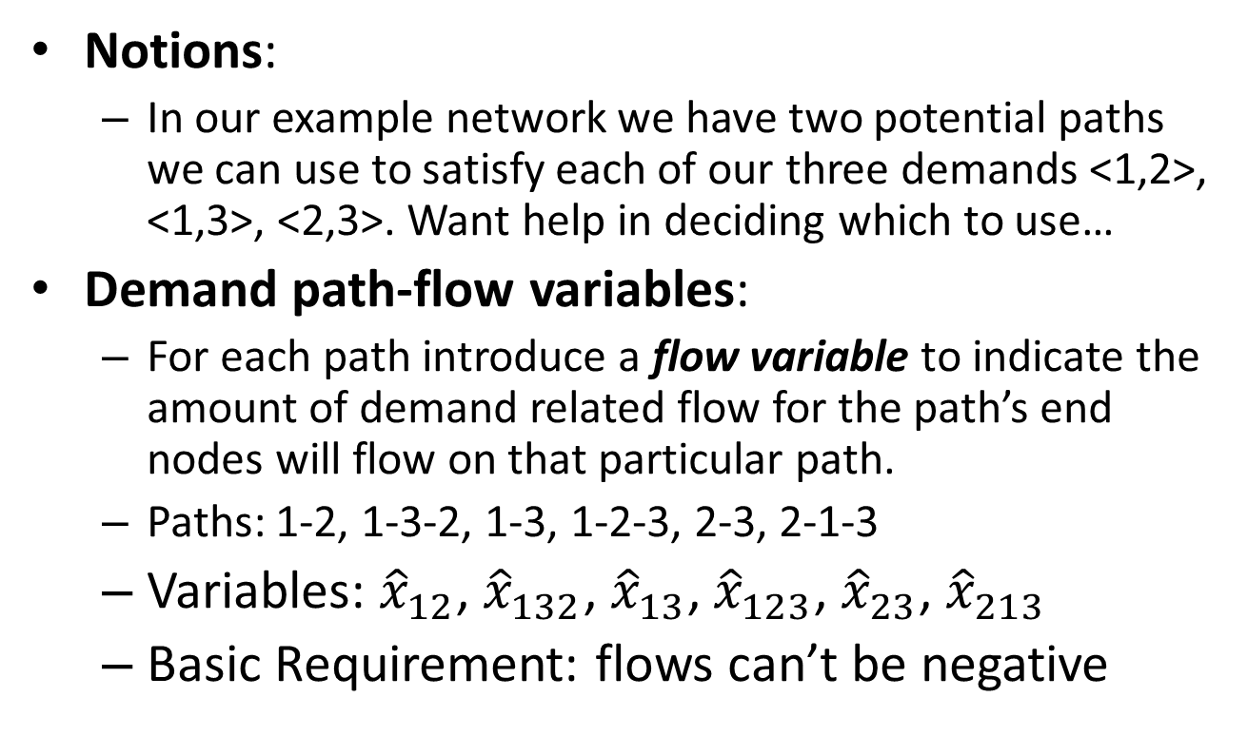
Demand Path Flow Variables
Notions:
In our example network we have two potential paths we can use to satisfy each of our three demands <1,2>, <1,3>, <2,3>. Want help in deciding which to use…
Demand path-flow variables:
For each path introduce a flow variable to indicate the amount of demand related flow for the path’s end nodes will flow on that particular path.
Paths: 1-2, 1-3-2, 1-3, 1-2-3, 2-3, 2-1-3
Variables: ${\hat{x}}_{12}$, ${\hat{x}}_{132}$, ${\hat{x}}_{13}$, ${\hat{x}}_{123}$, ${\hat{x}}_{23}$, ${\hat{x}}_{213}$
Basic Requirement: flows can’t be negative
3
1
2

Slide 13
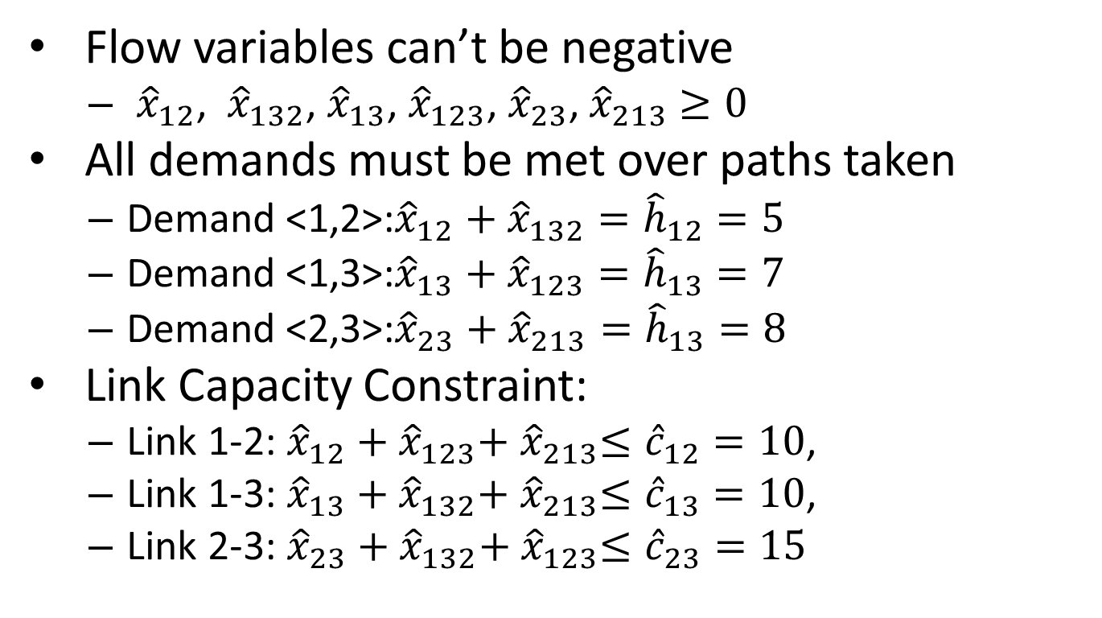
Constraints on Demand Path-Flow Variables
Flow variables can’t be negative
${\hat{x}}_{12}$, ${\hat{x}}_{132}$, ${\hat{x}}_{13}$, ${\hat{x}}_{123}$, ${\hat{x}}_{23}$, ${\hat{x}}_{213}$ $≥0$
All demands must be met over paths taken
Demand <1,2>:${\hat{x}}_{12}+{\hat{x}}_{132}={\hat{h}}_{12}=5$
Demand <1,3>:${\hat{x}}_{13}+{\hat{x}}_{123}={\hat{h}}_{13}=7$
Demand <2,3>:${\hat{x}}_{23}+{\hat{x}}_{213}={\hat{h}}_{13}=8$
Link Capacity Constraint:
Link 1-2: ${{\hat{x}}_{12}+{\hat{x}}_{123}{+ \hat{x}}_{213}≤\hat{c}}_{12}=10$,
Link 1-3: ${{\hat{x}}_{13}+{\hat{x}}_{132}{+ \hat{x}}_{213}≤\hat{c}}_{13}=10$,
Link 2-3: ${{\hat{x}}_{23}+{\hat{x}}_{132}{+ \hat{x}}_{123}≤\hat{c}}_{23}=15$

Slide 14
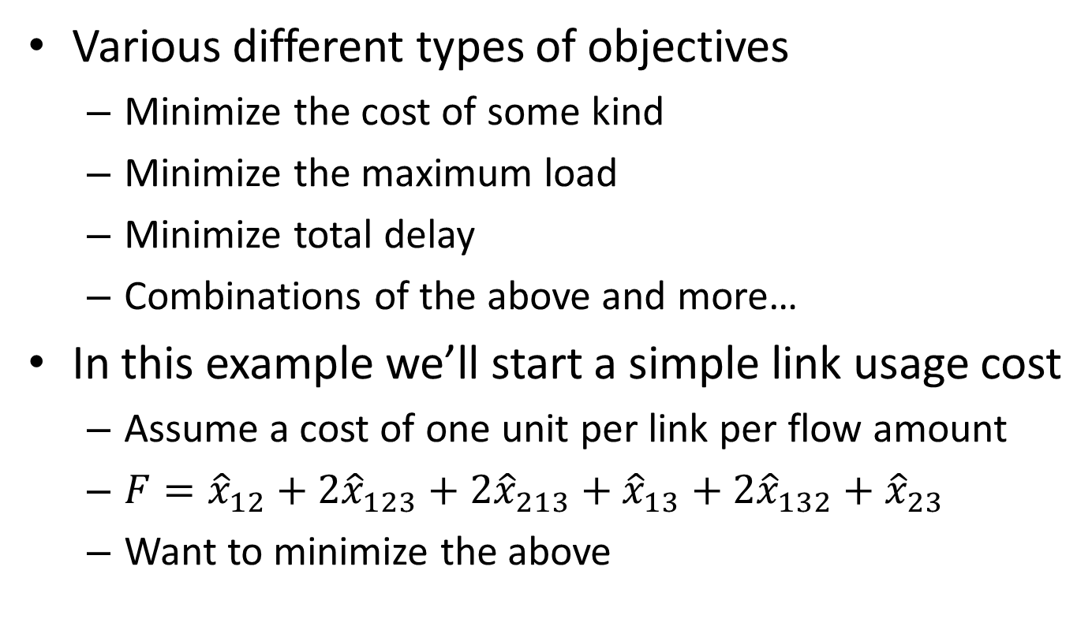
What’s our Objective?
Various different types of objectives
Minimize the cost of some kind
Minimize the maximum load
Minimize total delay
Combinations of the above and more…
In this example we’ll start a simple link usage cost
Assume a cost of one unit per link per flow amount
${F=\hat{x}}_{12}+{2\hat{x}}_{123}{+ 2\hat{x}}_{213}+ {\hat{x}}_{13}+{2\hat{x}}_{132}+{\hat{x}}_{23}$
Want to minimize the above

Slide 15
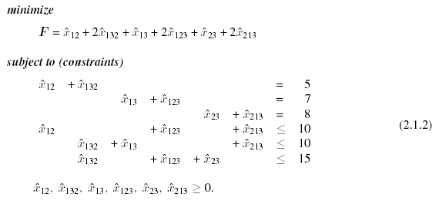
Putting it Together
Unit Cost based on path length
Demand constraints
Link capacity constraints
Solution:
From P&M,
modified by GB

Slide 16
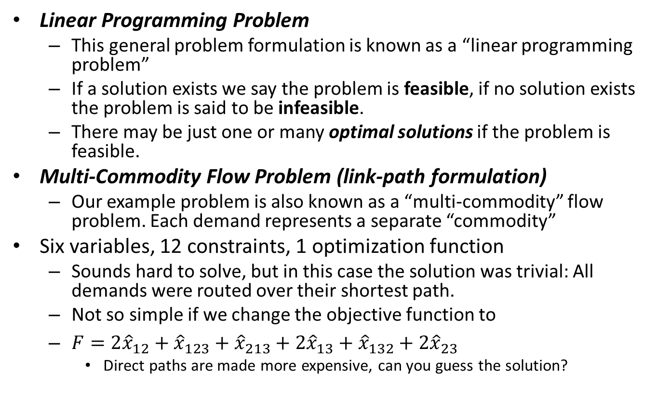
Comments
Linear Programming Problem
This general problem formulation is known as a “linear programming problem”
If a solution exists we say the problem is feasible, if no solution exists the problem is said to be infeasible.
There may be just one or many optimal solutions if the problem is feasible.
Multi-Commodity Flow Problem (link-path formulation)
Our example problem is also known as a “multi-commodity” flow problem. Each demand represents a separate “commodity”
Six variables, 12 constraints, 1 optimization function
Sounds hard to solve, but in this case the solution was trivial: All demands were routed over their shortest path.
Not so simple if we change the objective function to
${F=2\hat{x}}_{12}+{\hat{x}}_{123}{+ \hat{x}}_{213}+ {2\hat{x}}_{13}+{\hat{x}}_{132}+{2\hat{x}}_{23}$
Direct paths are made more expensive, can you guess the solution?

Slide 17
Linear programming (LP) I
Many optimization problems can be formulated exactly or approximately as LP problems. LP problems are also used in the solution of many much harder optimization problems
Some well known LP Software
lp_solve (http://lpsolve.sourceforge.net/5.5/)
CLP (https://projects.coin-or.org/Clp) Part of the COIN-OR project
GLPK (GNU Linear Programming Kit)
CPLEX (now part of IBM, commercial)

Slide 18
Linear programming (LP) II
Optimization Specific Languages
AMPL -- A Modeling Language for Mathematical Programming (http://www.ampl.com/)
GNU MathProg modeling language, which is a subset of the AMPL language
Well known LP file formats
“The CPLEX LP file format provides a facility for entering a problem in a natural, algebraic LP formulation from the keyboard.” To read this type of file with lp_solve IDE rename to use an .lpt extension.
“MPS is an old format, so it is set up as though you were using punch cards. Fields start in column 2, 5, 15, 25, 40 and 50. Sections of an MPS file are marked by so-called header cards, which are distinguished by their starting in column 1. Although it is typical to use upper-case throughout the file (like I said, MPS has long historical roots), many MPS-readers will accept mixed-case for anything except the header cards, and some allow mixed-case anywhere.”
From http://lpsolve.sourceforge.net/5.5/

Slide 19
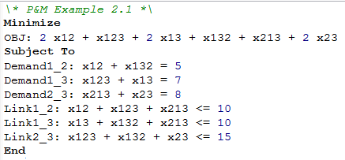
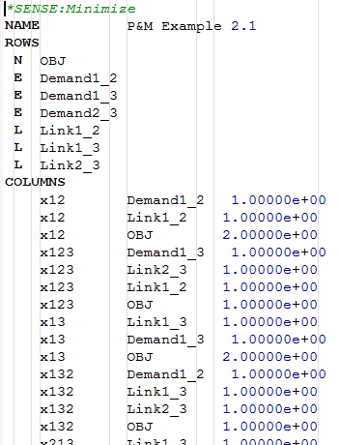
Linear programming (LP) III
CPLEX LP File Format for our example:
MPS File Format for our example:

Slide 20
Formulating LPs in this class
PuLP (http://www.coin-or.org/PuLP/)
“PuLP is an LP modeler written in python. PuLP can generate MPS or (CPLEX) LP files and call GLPK, COIN CLP/CBC, CPLEX, GUROBI to solve linear problems.”
Install into your python distribution via
easy_install -U pulp
Why?
Do you really want to learn yet another language, e.g. AMPL?
With Python we can generate LP/MIP/IP equations from a network description, e.g., an OO model of the network. Full programming power of a modern language.

Slide 21
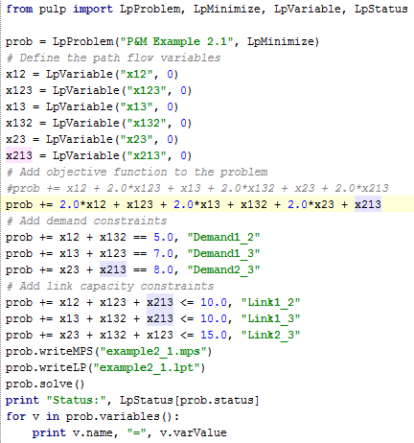
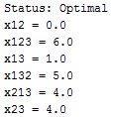
Brute Force PuLP usage
Example 2.1
Create an LpProblem
Create LpVariables
Add objective function
Add constraints equations
Save in standard formats
Solve using included solver (most likely COIN-OR CBC/CLP solver)
Can we automate this for general networks and path candidates?

Slide 22
Node Link Formulation I
Link path formulation issues
Where do we get the paths from?
A large network can have an extremely large number of paths
Use Demand Link Flow Variables
“Instead of tracing the path ﬂows realizing the demand volume of the considered demand, we consider the total link ﬂow for this demand on each link (many of such ﬂows will be in general equal to 0).”
(Page 43) Pioro & Medhi. Routing, Flow, and Capacity Design in Communication and Computer Networks.
For each link and each demand we define a variable that represents the flow on this link for this demand. In addition our network must be directed.

Slide 23
Node Link Formulation II
Flow Conservation Rule
Moreover, the total ﬂow realizing the considered demand incoming to the node (called transit or intermediate node in this context) is equal to the total ﬂow for this demand outgoing from the node. This is called ﬂow conservation law.
If the considered ﬁxed node is the source of the considered demand, then the total outgoing ﬂow minus the total incoming ﬂow must be equal to the demand volume.
Finally, if the ﬁxed node is the sink, then the total incoming ﬂow minus the total outgoing ﬂow must be equal to the demand volume.
(Page 43) Pioro & Medhi. Routing, Flow, and Capacity Design in Communication and Computer Networks.

Slide 24
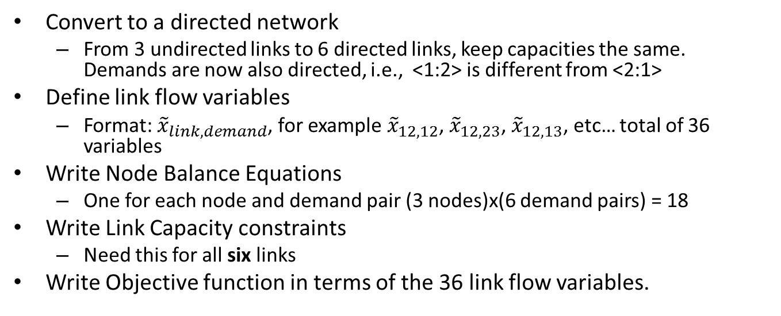
Node Link Formulation Example I
Convert to a directed network
From 3 undirected links to 6 directed links, keep capacities the same. Demands are now also directed, i.e., <1:2> is different from <2:1>
Define link flow variables
Format: ${\tilde{x}}_{link, demand}$, for example ${\tilde{x}}_{12,12}$, ${\tilde{x}}_{12, 23}$, ${\tilde{x}}_{12, 13}$, etc… total of 36 variables
Write Node Balance Equations
One for each node and demand pair (3 nodes)x(6 demand pairs) = 18
Write Link Capacity constraints
Need this for all six links
Write Objective function in terms of the 36 link flow variables.
3
3
1
2
1
2

Slide 25



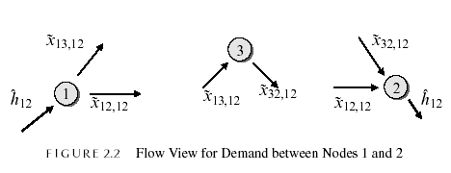
Node Link Formulation Example II
Write Node Balance Equations
One for each node and demand pair
Due to the ﬂow conservation law and using the convention that anything going into the node is negative and anything going out is positive, we may write the following equation for node 1:
(Page 44) Pioro & Medhi
For node 1
For node 3
For node 2
From P&M,
modified by GB

Slide 26
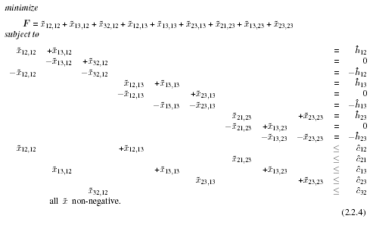
Node Link Formulation Example III
Equations (after assumptions that some variables are zero)
From P&M,
modified by GB

Slide 27
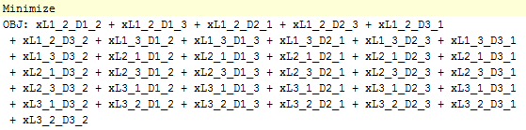
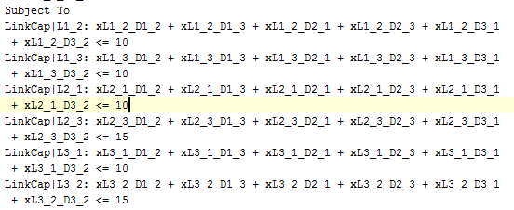
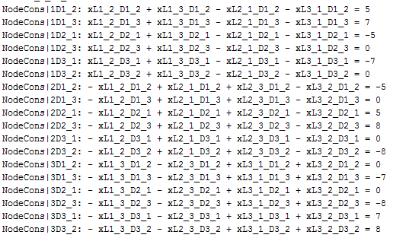
Actual full LP formulation
Objective function in 36 link flow variables (6 links, 6 demands)
Link capacity constraints: 6 directional links
Node conservation (balance) constraints: 18 (3 nodes, 6 demands)

Slide 28
Generating Equations via Python
Python tuples, lists, and dictionaries
Can greatly simplify the generation of network design equations
Links and demand pairs ➔ Python tuples
Demand volumes ➔ Python dictionary (indexed by a tuple), e.g., demands[(“n1”,”n2”)] = 10
Lists are great for keeping track of all nodes and links in a network, good for node or link representation of paths
Dictionaries are a good place to keep link flow variables for easy access.

Slide 29
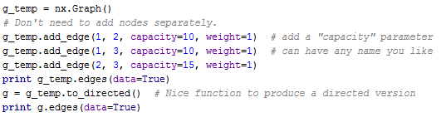

Graph and Demands in Python
Short cut to a directed graph (NetworkX)
Demands (directed) via a python dictionary

Slide 30


Defining LP Variables
Start with nice sorted lists of demands, links, and nodes
Use a Python dictionary (link_flows) to keep track of LP variables
Give LP variables useful names!

Slide 31

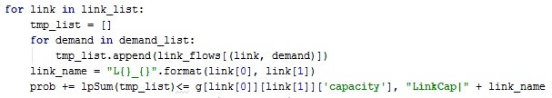
Use LP variables to define Objective and Constraints
Objective function (based on link weights)
A weighted sum over all link flow variables
Link Capacity Constraints

Slide 32
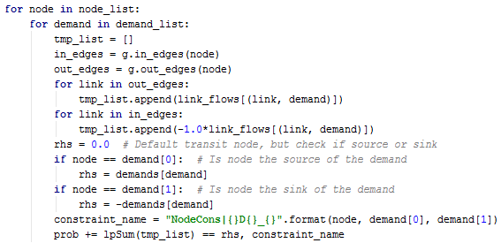
Node Balance Constraints
An equation for each node and demand pair
Need to know links entering node and leaving node. Nice member functions in NetworkX

Slide 33
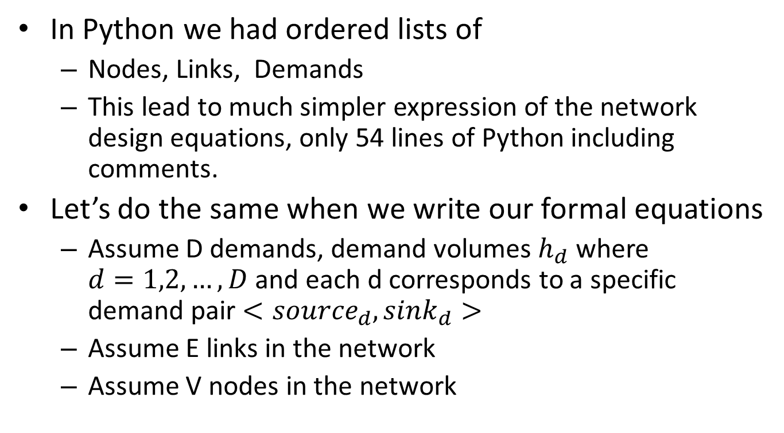
Notions and Notation
In Python we had ordered lists of
Nodes, Links, Demands
This lead to much simpler expression of the network design equations, only 54 lines of Python including comments.
Let’s do the same when we write our formal equations
Assume D demands, demand volumes $h_{d}$ where $d=1,2,…,D$ and each d corresponds to a specific demand pair $<{source}_{d},{sink}_{d}>$
Assume E links in the network
Assume V nodes in the network

Slide 34
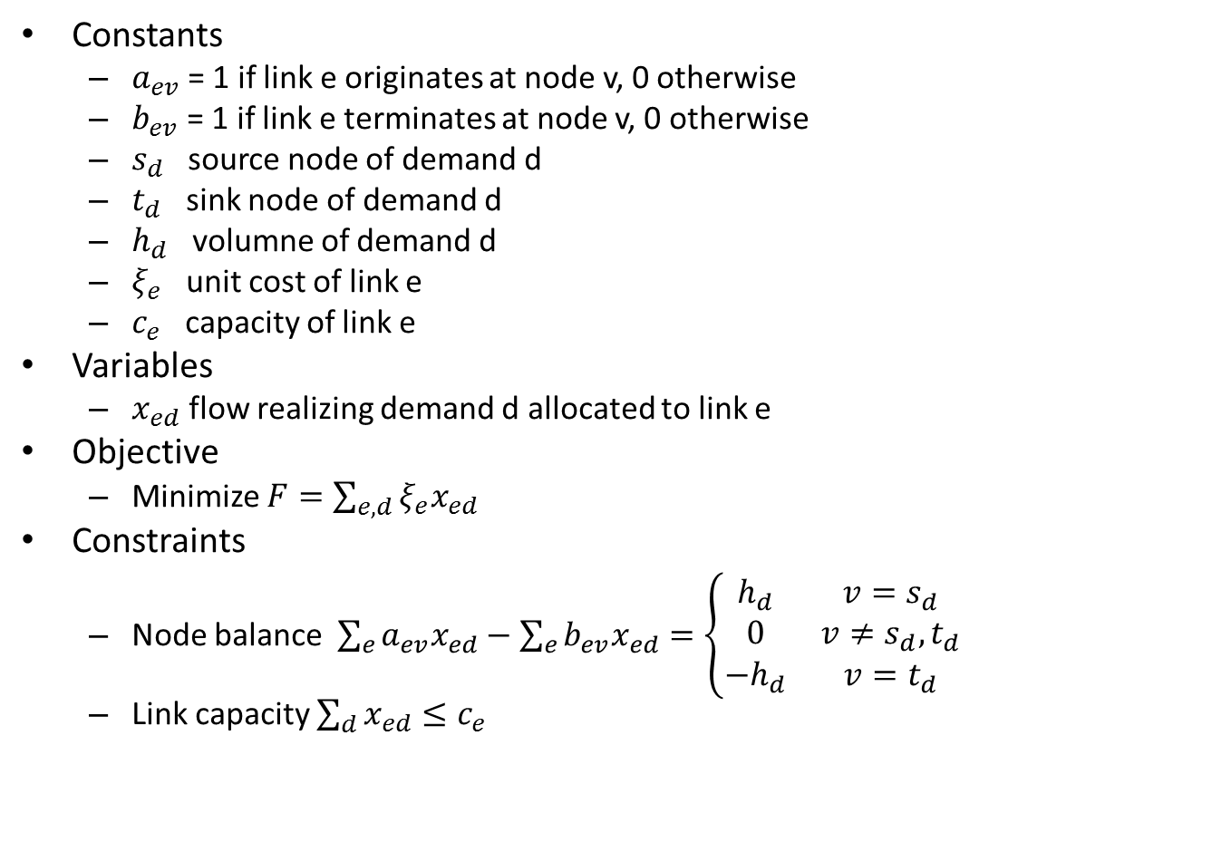
General Basic Node Link Formulation
Constants
$a_{ev}$ = 1 if link e originates at node v, 0 otherwise
$b_{ev}$ = 1 if link e terminates at node v, 0 otherwise
$s_{d}$ source node of demand d
$t_{d}$ sink node of demand d
$h_{d}$ volumne of demand d
$ξ_{e}$ unit cost of link e
$c_{e}$ capacity of link e
Variables
$x_{ed}$ flow realizing demand d allocated to link e
Objective
Minimize $F=\sum_{e,d}{ξ_{e}x_{ed}}$
Constraints
Node balance $\sum_{e}{a_{ev}x_{ed}}−\sum_{e}{b_{ev}x_{ed}}=\left\{\begin{matrix}h_{d} & v=s_{d} \\ 0 & v≠s_{d},t_{d} \\ −h_{d} & v=t_{d}\end{matrix}\right.$
Link capacity $\sum_{d}{x_{ed}}≤c_{e}$
Similar to the design problem of section 4.1 page 108 of P&M

Slide 35
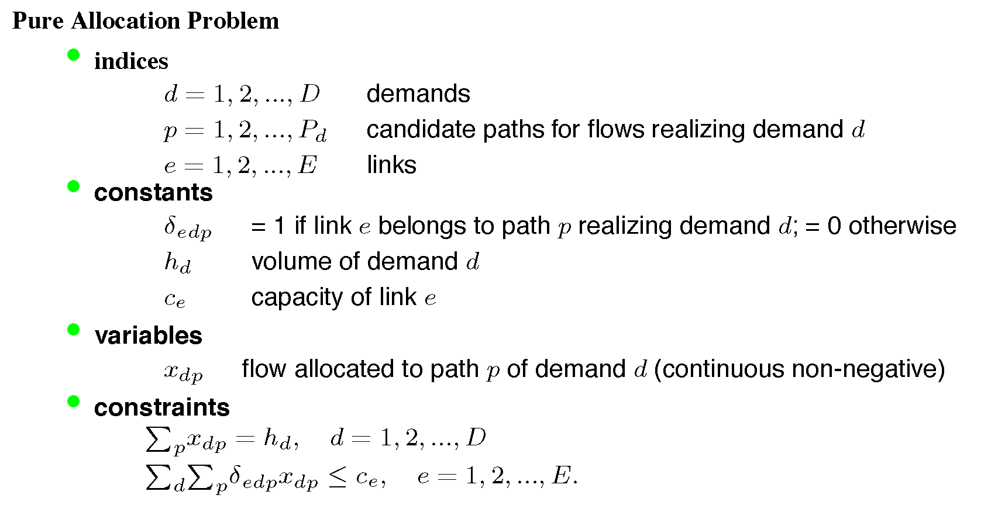
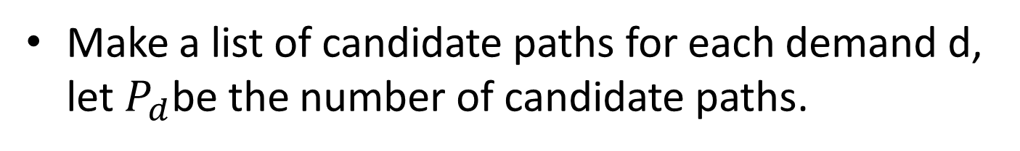
Link Path Formulation
Make a list of candidate paths for each demand d, let $P_{d}$be the number of candidate paths.
See page 112 of P&M
From P&M,
modified by GB

